Slide 1
Field Effect Transistors - FETs
Introduction:
  Definition: A 3 terminal device in which current flowing between two of the terminals is regulated by an applied voltage on the third.
Basic Structure:
  p-n junctions whose depletion regions are regulated by a voltage.
Physical Operating Principle:
  FETs capitalize on the ability to vary W in a p-n junction with the application of a reverse bias.

Slide 2
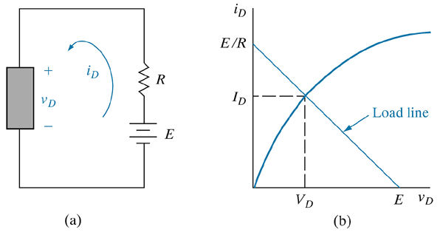
A Two-terminal Nonlinear Device
biasing circuit;
(b) I–V characteristic and load line.

Slide 3
Field Effect Transistors - FETs
Types of FETs
  JFET: junction FET
  MESFET: metal-semiconductor FET
  MISFET: metal-insulator-semiconductor FET
  MOSFET: metal-oxide-semiconductor FET (specifically for Si devices)
Basic construction consists of source, gate, and drain terminals
  source and drain terminals are connected by a channel

Slide 4
Field Effect Transistors - FETs
The regulating voltage is applied to the gate terminal.
  The gate consists of a p-n junction, Schottky contact or MOS capacitor
General Operation:
  Load-line analysis is used to define transistor operation – see Fig. 6-2

Slide 5
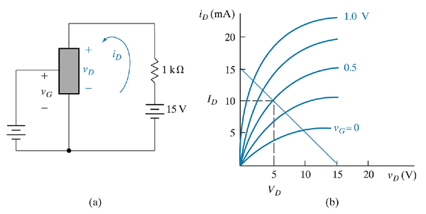
A three-terminal nonlinear device that can be controlled by the voltage at the third terminal v_{G}: (a) biasing circuit; (b) I–V characteristic and load line. If v_{G} = 0.5 V, the d-c values of I_{D} and V_{D} are as shown by the dashed lines.

Slide 6
Field Effect Transistors - FETs
Uses
  Switching
    the gate voltage allows for switching as per the load-line
  Amplification
    If the gate voltage has an a-c component to the control input voltage, the a-c signal will be amplified at the drain output as per the load-line analysis

Slide 7
Junction FET
General Description: A voltage variable depletion region width (W) of a p-n junction is used to control the effective cross sectional area of a conducting channel
General Operation (see Fig 6-4):
  current flows thru the n-type channel
  reverse bias applied to p-type gates (usually there are two of them)
  depletion region extends into channel, reducing the cross-sectional area of the conducting region (undepleted n-type region)

Slide 8
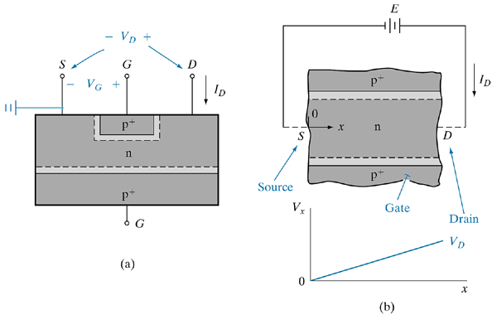
Simplified cross-sectional view of a junction FET: (a) transistor geometry; (b) detail of the channel and voltage variation along the channel with V_{G} = 0 and small I_{D}.

Slide 9
Junction FET
  this increases the resistance in the conducting n-type region
  this leads to a voltage drop across the channel which further increases the depletion region near the drain, causing an asymmetry in the channel cross sectional area.
  Pinch-off will occur where the depletion regions encompass the entire n-type region, leaving a small cross sectional area that is completely depleted. Current saturation is achieved at this point.
    Ohm’s law says V=IR, or R = V/I, so dR = dV/dI
    If dR is increasing rapidly as the device approaches pinch-off, either dV is getting very large or dI is getting very small. Its dI that gets small and I reaches saturation.

Slide 10
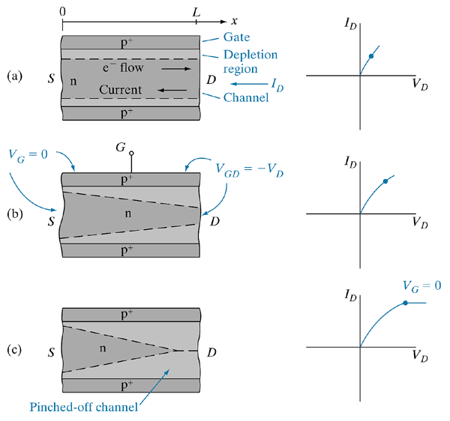
Depletion regions in the channel of a JFET with zero gate bias for several values of V_{D} :
linear range;
(b) near pinch-off;
(c) beyond pinch-off.

Slide 11
Junction FET
Control of a JFET:
  For negative values of gate voltage, pinch-off will occur at lower values of drain voltage and thus the saturation drain current is lower (see Fig 6-5)
    A depletion region is set up in the n-type region
    The region is uniform relative to the zero gate voltage, high current case
Performance parameters that can be calculated
  Pinch-off voltage: Related to doping of n-region
  I_{D} and I_{D(sat)}

Slide 12
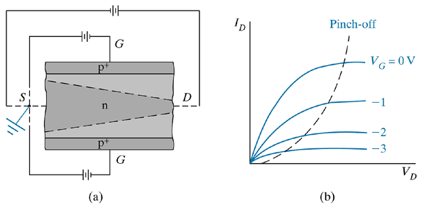
Effects of a negative gate bias: (a) increase of depletion region widths with V_{G} negative; (b) family of current–voltage curves for the channels as V_{G} is varied.

Slide 13
JFET
Summary of Pinch-off
  The depletion regions on either side of channel meet
  At pinch-off, I_{D} does not increase linearly with V_{D}, but does so more slowly
  Depletion regions are loaded with fixed charges with associated electric field
    In n-type channel, the fixed charge is positive
    Electrons are swept across the region by the electric field
  With respect to Ohm’s Law
    V = IR → dR = dV/dI which gets very high
    So as V increases, I increases very little
    To a good approximation, we can assume that I doesn’t increase with V above V_{P}

Slide 14
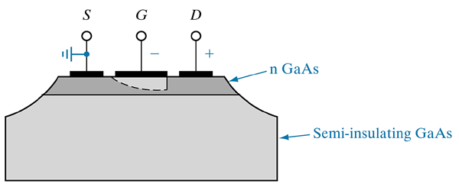
GaAs MESFET formed on an n-type GaAs layer grown epitaxially on a semi-insulating substrate. In this example the device is isolated from others on the same chip by etching through the n region to the semi-insulating substrate.

Slide 15
MESFET
Definition:
  Basically it’s a JFET that uses a reversed biased Schottky contact instead of a p-n junction to regulate current flow in the channel.
Main uses:
  High speed digital and microwave devices that require very tight geometric tolerances. Schottky contacts have very sharp interfaces with semiconductors, unlike some p-n junctions

Slide 16
MESFET
Example: GaAs MESFET (Figure 6.7)
  Description:
    Substrate: semi-insulating GaAs
    Semiconducting layer: n-type GaAs epitaxial thin film
  Why GaAs
    Higher electron mobility than Si
    Allows for tight geometric tolerances by way of epi growth or ion implantation
    Channel length L of 0.25 microns possible.

Slide 17
HEMT
High Electron Mobility Transistor
  Definition: a device that uses heterojunctions to increase the conductivity of the channel without using doping to do so.
  Why important: increasing conductivity via doping tends to decrease the mobility due to impurity scattering
Structure
  A thin undoped well is bounded by doped barriers of a higher bandgap (AlGaAs-GaAs-AlGaAs)
  This leads to a potential well

Slide 18
HEMT
Effect
  Electrons in the doped boundary regions diffuse into the GaAs and become trapped in the well
  The effect is to separate the donors from their electrons physically
  The net effect is to get numerous electrons in an otherwise undoped (or lightly doped) region
  Conductivity is enhances but mobility is not lowered.
Important characterstics
  Large electron density (10¹²/cm²)
  Very thin undoped layer (< 10 nm)
  Close proximity to the gate

Slide 19
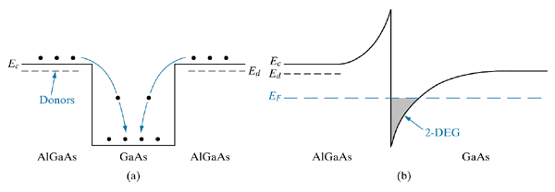
Simplified view of modulation doping, showing only the conduction band. Electrons in the donor-doped AIGaAs fall into the GaAs potential well and become trapped. As a result, the undoped GaAs becomes n-type, without the scattering by ionized donors which is typical of bulk n-type material.
(b) Use of a single AIGaAs/GaAs heterojunction to trap electrons in the undoped GaAs. The thin sheet of charge due to free electrons at the interface forms a two-dimensional electron gas (2-DEG), which can be exploited in HEMT devices.

Slide 20
MISFETs
MISFETs: Metal-Insulator-Semiconductor Field Effect Transistors
Working Definition:
  A FET where the channel current is controlled by a voltage applied at a gate electrode that is isolated from the channel by an insulator
Basic Structure for an enhancement type n-channel MOSFET:
  See Figure 6-10
  Common materials of construction:
    Si for the semiconductor
    SiO₂ for the insulator
    Al, doped polysilicon for the gate

Slide 21
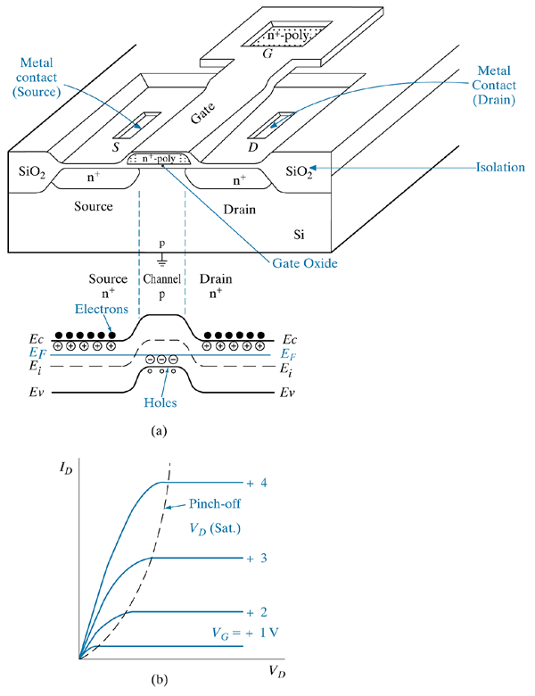
An enhancement-type n-channel MOSFET
isometric view of device and equilibrium band diagram along channel;
(b) drain current—voltage output characteristics as a function of gate voltage.

Slide 22
MISFETs
Basic Operation: (Figure 6-10)
  Gate voltage = 0
    No current flow due to dual potential barriers of the back-to-back p-n junctions
  Gate voltage = positive
    Positive charges on metal induce negative charges in channel by the formation of a depletion region and a thin electron layer at the surface
    Negative charges make p-type region more n-type
    The energy barrier becomes lowered because the conduction and valence bands are lowered and as a result, a conducting n-channel is formed.
    The n-type conductivity of the channel is gate voltage dependent, with a threshold voltage, V_{T}

Slide 23
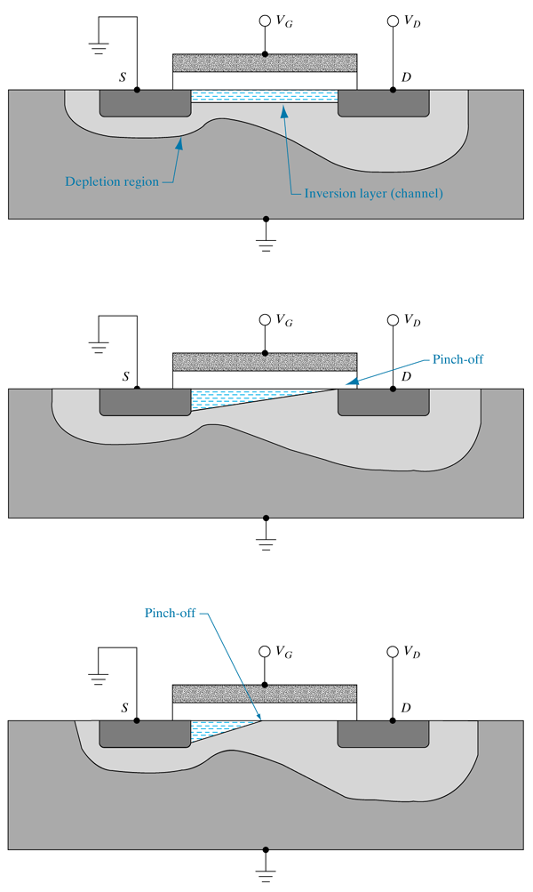
n-channel MOSFET under different operating conditions
(a) linear region for V_{G} > V_{T} and V_{D} < (V_{G} - V_{T});
(b) onset of saturation at pinch-off, V_{G} > V_{T} and V_{D} = (V_{G} - V_{T});
(c) strong saturation, V_{G} > V_{T} and V_{D} > (V_{G} - V_{T} ).

Slide 24
Band Diagrams for MOS Capacitors
Analysis using Energy Band Diagrams
  Modified work functions for the metal and semiconductor layers are used. The modified work function describes the energy required to move electrons from the associated Fermi level to the conduction band of the insulator
    qΦ_{m} is the modified work function for metal
    qΦ_{s} is the modified work function for the semiconductor
    in the semiconductor, qΦ_{F} = E_{i} – E_{F}

Slide 25
Band Diagrams for MOS Capacitors
V < 0 (Accumulation)
  holes accumulate on the semiconductor side of the SC/Insulator interface. Called hole accumulation.
  E_{F} is raised by an amount qV due to electrons accumulating at the metal/SC interface.
  The charge accumulation results in an electric field across the insulator
  The E field causes a gradient in the oxide conduction band.

Slide 26
Band Diagrams for MOS Capacitors
  Hole accumulation requires that the difference between E_{F} and E_{i} to increase in the accumulation region. This happens by band bending in this region. The bands bend to reflect the distribution of charge carriers in the semiconductor.
  For hole accumulation in p-type material, the bands bend upward.
V > 0 (Depletion)
  E_{F} of the metal is lowered by qV as a result of the positive voltage
  Negative charge accumulates at the surface of the semiconductor in response to the charge.

Slide 27
Band Diagrams for MOS Capacitors
  In p-type material, this results in the depletion of holes at the interface. The negative charge results from uncompensated ionized acceptors in this region and electrons accumulating there.
  An E field is created and the energy levels in the insulator has a gradient
  In the semiconductor, E_{F} remains fixed. The energy bands bend downward to reflect the redistribution of charge as a function of position.

Slide 28
Band Diagrams for MOS Capacitors
The Depletion Situation (V > 0)
  E_{i} bends towards E_{F} in order to make the depletion region be more n-like
  The band bending is voltage dependent such that as the voltage increases, so does the bending.
  In some situations, E_{i} can bend below E_{F}, thus implying a large electron concentration in E_{c}
  When the positive voltage gets high enough, the region very near the interface inverts from p-type to n-type.

Slide 29
Band Diagrams for MOS Capacitors
The Inversion Situation (V >> 0)
  How high does the positive voltage need to go?
  Let qΦ_{s} = the amount of band bending at the semiconductor surface relative to Ei
  When V = 0, qΦ_{s} = 0 (called the flat-band situation)
  For qΦ_{s} < 0, accumulation (bands bend up)
  For qΦ_{s} > 0, depletion (band bends down)
  When Φ_{s} > Φ_{F}, then E_{i} < E_{F} and inversion has occurred

Slide 30
Band Diagrams for MOS Capacitors
Strong Inversion
  Occurs when the inversion region is as strongly n-type as the bulk of the semiconductor is p-type
  The Debye screening length (L_{D})
    It is an indication of the distance in which charge imbalances are screened as to appear neutral
    L_{D} is inversely dependent on doping concentration.
    L_{D} can be derived by examining the E field at the surface of the semiconductor

Slide 31
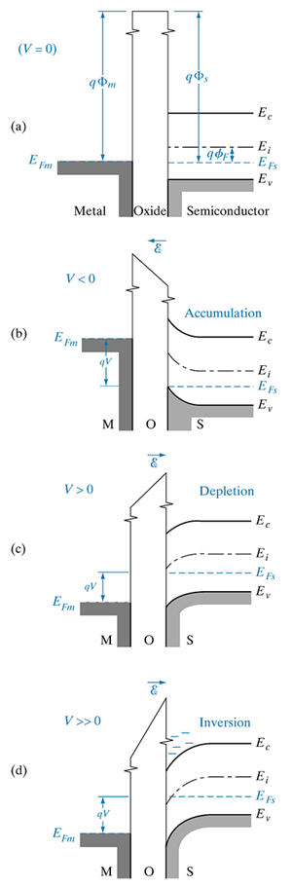
Figure 6—12
Band diagram for the ideal MOS structure at:
equilibrium;
negative voltage causes hole accumulation in the p-type semi-conductor

Slide 32
Figure 6—12
Band diagram for the ideal MOS structure at:
(c) positive voltage depletes holes from the semiconductor surface:
(d) a larger positive voltage causes inversion — a “n-type” layer at the semiconductor surface.

Slide 33
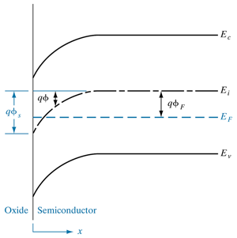
Bending of the semiconductor bands at the onset of strong inversion: the surface potential φ_{s} is twice the value of φ_{F} in the neutral p material.

Slide 34
Charge Density (Q_{S}) vs Surface Potential (Φ_{s})
See Figure 6-14 in the context of Equation 6-24
  V = 0
    Φ_{S} = 0, Q_{S} = 0
  V < 0
    Majority carriers (holes) accumulated at the surface (within 20 nm)
    Q_{S} is proportional to exp(-qΦ_{s}/kT)
  V > 0
    The region is being depleted of holes
    Q_{S} is proportional to (Φ_{s})1/2
    Weak inversion is occurring
    Layer thickness is about 100 nm

Slide 35
Charge Density (Q_{S}) vs Surface Potential (Φ_{s})
  V >>0
    When Φ_{s} ≥ 2Φ_{F}, strong inversion occurs.
    Q_{s} is proportional to exp(qΦ_{s}/kT)
    The layer thickness is 5 nm
The Depletion Region
  The width of the depletion region (W) can be expressed in terms of qΦ_{s} and the doping concentration
  W will grow with increasing voltage until strong inversion occurs. At this point, W will not continue growing, but rather, inversion will only grow stronger.
  W_{max} is proportional to qΦ_{s} at inversion

Slide 36
Charge Density (Q_{S}) vs Surface Potential (Φ_{s})
Threshold Voltage
  Inversion occurs at a threshold voltage V_{T}
  V_{T} = -(Q_{d}/C_{i}) + 2 Φ_{F}
  Where Q_{d} is the charge/unit area in the depletion region

Slide 37
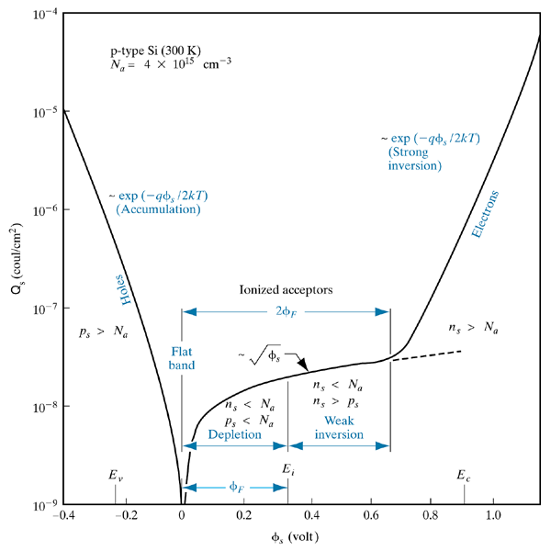
Variation of space-charge density in the semiconductor as a function of the surface potential φ_{s} for p-type silicon with N_{a} = 4 3 10¹⁵ cm²³ at room temperature. p_{s} and n_{s} are the hole and electron concentrations at the surface, φ_{F} is the potential difference between the Fermi level and the intrinsic level of the bulk.

Slide 38
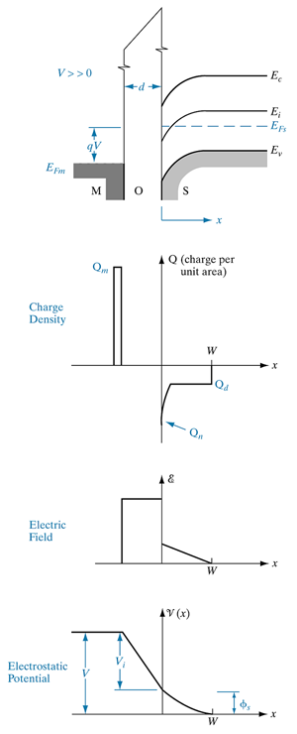
Approximate distributions of charge, electric field, and electrostatic potential in the ideal MOS capacitor in inversion. The relative width of the inverted region is exaggerated for illustrative purposes, but is neglected in the field and potential diagrams.

Slide 39
Capacitance Characteristics of MOS Structures
Capacitances in MOS structures have components that are voltage dependent and voltage independent
  The capacitance of a MOS structure is the series combination of the insulator capacitance (Ci) and the semiconductor capacitance (C_{s})
    C_{S} is voltage dependent
    C_{i} is voltage independent
    The series combination is voltage dependent
  Key C-V relationships (See Figure 6-16)
    V < 0, The accumulation region
      C_{S} is high because the accumulated charge increases with increasing Φ_{s}
      Series capacitance ~ C_{i}

Slide 40
Capacitance Characteristics of MOS Structures
    V = small
      Series capacitance C = (C_{i}C_{d})/(C_{i} + C_{d}) where C_{d} is C_{S} but only in the depletion region
      C < C_{i}
    V > 0, The inversion region
      C has a frequency dependence
        Low frequencies ( 1 to 100 Hz)
        Charges can respond to changes in voltage
        C_{S} is small
        C = (C_{i}C_{d})/(C_{i} + C_{d}) as in the depletion region
        High frequencies (1 MHz)
        Charges cant respond fast enough
        C = C_{i} because C_{S} is small
      What about the frequency dependence in the accumulation region?
        There is none because the charge carriers are majority carriers and they respond very fast to voltage changes

Slide 41
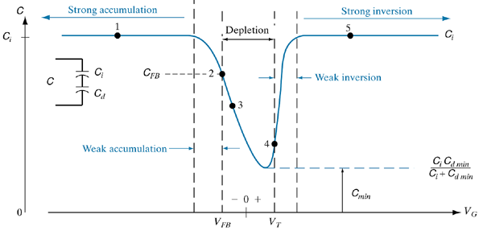
Capacitance–voltage relation for an n-channel (p-substrate) MOS capacitor. The dashed curve for V > V_{T} is observed at high measurement frequencies. The flat band voltage V_{FB} will be discussed in Section 6.4.3. When the semiconductor is in depletion, the semiconductor capacitance C_{S} is denoted as C_{D}.

Slide 42
Effects of Real Surfaces
Work Function Differences (φ_{ms})
    φ_{s} depends on the doping of the semiconductor
    φ_{ms} is the work function potential difference between the metal and semiconductor
  See Figure 6-17 for a functional relationship
  Characteristics of φ_{ms}
    Is always negative
    Is more negative for p-type Si than n-type Si
    Significance:
      A negative φ_{ms} means that energy bands in MOS device bend down at V = 0
      If φ_{ms} is sufficiently negative, inversion can occur at V = 0. So to obtain the flat-band condition, a negative voltage must be applied

Slide 43
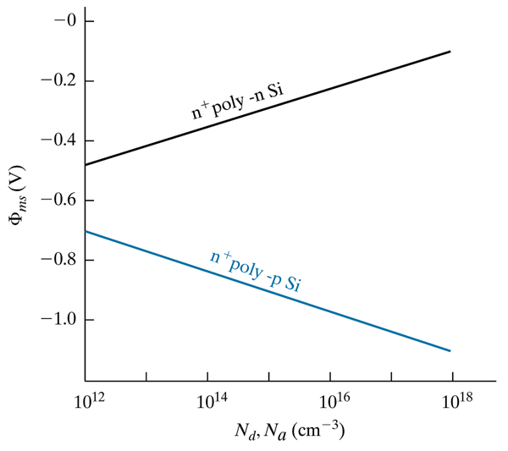
Variation of the metal–semiconductor work function potential difference F_{ms} with substrate doping concentration, for n⁺ poly-Si.

Slide 44
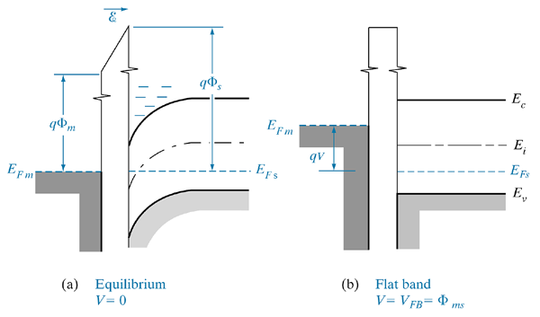
Effect of a negative work function difference (F_{ms} < 0):
band bending and formation of negative charge at the semiconductor surface;
(b) achievement of the flat band condition by application of a negative voltage.

Slide 45
Effects of Real Surfaces
Charges in the Insulator
  Mobile Ion charge:
    caused by sodium ion accumulation in the insulator (oxide)
    Causes negative charges to accumulate in the semiconductor
    Sodium is highly mobile and its mobility is influenced by temperature and electric fields
    Mobility causes the device to have a voltage- or temperature-dependent history
    These are always positive

Slide 46
Effects of Real Surfaces
  Oxide Trapped Charge:
    caused by charges trapped in the oxide defects
    can be positive or negative
  Interface Trap Charge:
    positive charges resulting from interface states at the semiconductor/insulator interface.
    due to an abrupt termination of the Si lattice (dangling bonds)
    positive charge
  Oxide Fixed Charge:
    Caused by a transition layer (SiO_{x}) at the interface

Slide 47
Effects of Real Surfaces
Net effect of these charges:
  a net positive charge accumulates at the semiconductor/insulator interface inducing a negative charge in the semiconductor.
  This modifies the flat band and threshold voltages
  See Fig. 6-19

Slide 48
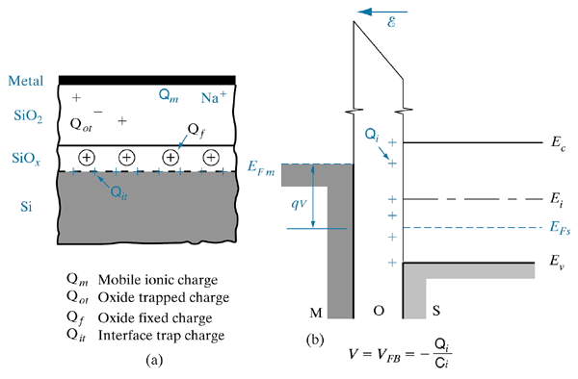
Effects of charges in the oxide and at the interface: (a) definitions of charge densities (C/cm²) due to various sources; (b) representing these charges as an equivalent sheet of positive charge Q_{i} at the oxide-semiconductor interface. This positive charge induces an equivalent negative charge in the semiconductor, which requires a negative gate voltage to achieve the flat band condition.

Slide 49
Threshold Voltage
Device Types
  for p-channel device, it is always negative
    negative voltage on gate is required to induce positive voltage on channel
    negative threshold voltage means that the applied voltage must be larger than the threshold voltage to achieve strong inversion
  for n-channel device it could be either positive or negative
    positive voltage is needed to invert the channel
    positive threshold voltage:

Slide 50
Threshold Voltage
Implications
  applied voltage mush be larger than the threshold voltage to achieve strong inversion.
  negative threshold voltage
    channel already exists at V = 0
    a negative voltage is thus needed to turn the device off
Implications with respect to doping:
  Lightly doped substrates are used in MOSFETS to maintain a high breakdown voltage for the drain junction.
See Fig. 6-20
  This figure indicates that the threshold voltage will be negative for lightly doped n-channel devices which creates the above detailed problem

Slide 51
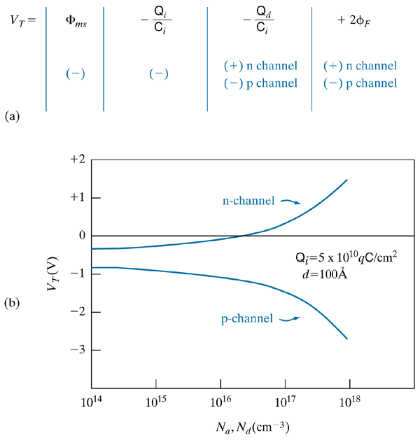
Influence of materials parameters on threshold voltage
the threshold voltage equation indicating signs of the various contributions;
(b) variation of V_{T} with substrate doping for n-channel and p-channel n⁺ poly-SiO₂–Si devices.

Slide 52
MOS C-V Analysis
Parameters affecting the C-V characteristics
  insulator thickness
  substrate doping: See Figure 6-21
    p-type substrate: asymmetric for low frequencies
    n-type substrate: symmetric for low frequencies
MOS Parameters from C-V Measurements
  Fast interface state density:
    defects that can change the state quickly in response to changes in gate bias. These states move above or below the Fermi level in response to the gate bias. Movement is due to band bending, not physical movement

Slide 53
MOS C-V Analysis
  Fixed Oxide Charge
    its effect on C-V characteristics depends on how many and where they are positioned in the insulator
  Mobile Ion Charge
    Because they are mobile, they can make the C-V characteristics highly variable over time.

Slide 54
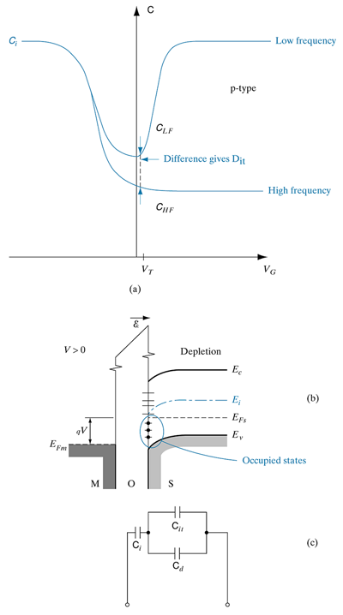
Fast interface state determination
High frequency and low frequency C—V curves showing impact of fast interface states;
energy levels in the bandgap due to fast interface states;
equivalent circuit of MOS structure showing capacitance components due to gate oxide (C_{i}), depletion layer in the channel (C_{d}) and fast interface states (C_{it}).

Slide 55
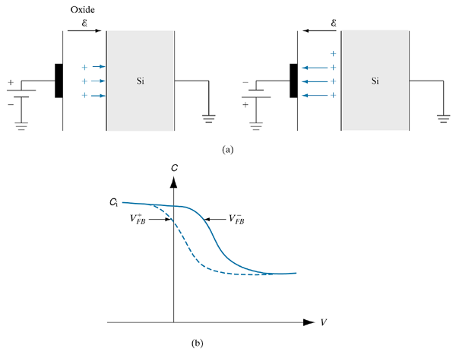
Mobile ion determination: (a) Movement of mobile ions due to positive and negative bias-temperature stress; (b) C—V characteristics under positive (dashed line) and negative (solid line) bias-temperature.

Slide 56
C-V Characteristics of MOS Oxides
Real gate insulators are leaky, often with a voltage dependence
Leakage mechanisms
  Fowler-Nordheim Tunneling:
    essentially electrons tunnel thru the oxide by “hopping” along the oxide conduction band
  Direct Tunneling:
    follows classical tunneling mechanisms and is becoming increasingly significant as device sizes are decreased.

Slide 57
C-V Characteristics of MOS Oxides
Time Dependent Dielectric Breakdown (TDDB)
  Figure 6-25 illustrates the mechanism
  The basics:
    electrons tunnel into the oxide from the gate electrode
    these electrons have kinetic energy due to the electric field across the oxide – called “hot” electrons
    some electrons cause impact ionization in the oxide, resulting in the creation of electron-hole pairs
    The electrons are attracted to the positively biased substrate, while the holes are attracted to the negatively biased gate electrode.
    Electron mobility in oxide is really low, so many electrons get trapped in the oxide

Slide 58
C-V Characteristics of MOS Oxides
    This enhancement of electrons in the oxide as well as entrapment of these electrons alters the electric field in the oxide in a way that the field gets stronger near the gate electrode
    The increased field strength reduces the barrier for electron tunneling and increases the energy of the tunneling electrons
    This leads to enhanced impact ionization and subsequent electron-hole pair generation which leads to a strengthened electric field in the oxide
    The process can cascade in this way, leading to breakdown of the oxide.

Slide 59
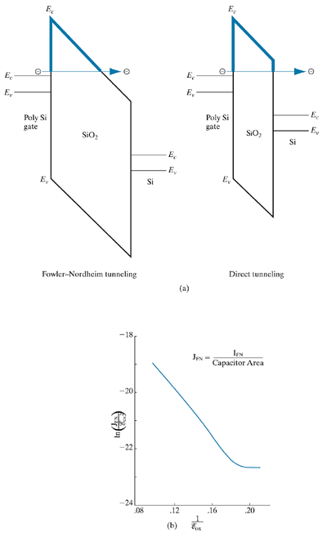
Current–voltage characteristics of gate oxides
Fowler–Nordheim and direct tunneling through thin gate oxides;
plot of Fowler–Nordheim tunneling leakage current as a function of electric field across the oxide.

Slide 60
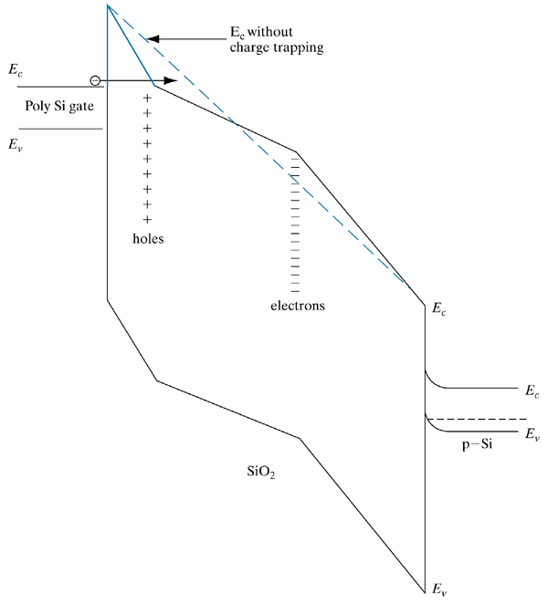
Time-dependent dielectric breakdown of oxides: Band diagram of a MOS device showing the band edges in the polysilicon gate, oxide and Si substrate. Trapped holes and electrons in the oxide distort the band edges, and increase the electric field in the oxide near the gate. The tunneling barrier width is seen to be less than if there were no charge trapping (dashed line).

Slide 61
MOSFET
Metal-Oxide-Semiconductor FET
  Also called surface field effect transistor since the channel is confined to the near surface region of the semiconductor.
  Output characteristics can be expressed in terms of gate voltage, drain voltage and drain current

